Slide 1
Crowding Data Extraction, Estimation, Prediction

Slide 2
ETM Data Extraction
Input -> Raw ETM Data
Output -> Route/Schedule Level, Trip Level Ticket data
Crowding Estimation
Input -> Route/Schedule Level, Trip Level Ticket data
Output -> Route/Schedule Level Demand data, Real-Time Trip Level Crowding Level data
Crowding Prediction
Input -> Historical Route Level Demand data
Output -> Real-Time Demand data

Slide 3
ETM Data Cleaning
Time discrepancies
Input -> Raw ETM Data
Output -> Clean ETM Data
ETM Data Extraction
Route level data extraction
Trip level data extraction
Input -> Clean ETM data
Output-> Route level / trip level ticket data
Stages ordering
Manual ordering for select routes/schedules
Plotting the stages in Google Maps

Slide 4
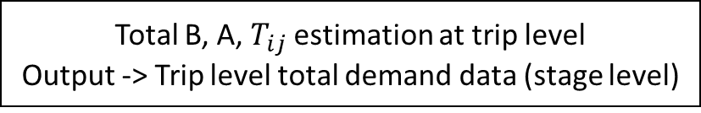
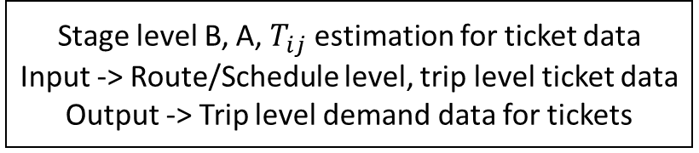
Extracted ETM data
Stage level B, A, $T_{ij}$ estimation for ticket data
Input -> Route/Schedule level, trip level ticket data
Output -> Trip level demand data for tickets
Pass holder model
Input -> Trip Level Demand data for tickets
Output -> Trip level Demand data for tickets and pass holders
Input -> Stage level ETM Data, Number of stops for each stage
Output -> Grouped Stop Level Tickets
Mean shift Clustering
Kernel Density Optimization
Changepoints/Breakpoints method
Demand Prediction
Input -> Testing data, ML Models
Output -> Real time demand data at stage
Total B, A, $T_{ij}$ estimation at trip level
Output -> Trip level total demand data (stage level)
Determination of Crowding Level
Input -> Real time demand data at stage, Stages ordered file
Output -> Real time demand data with crowding level
From State Space Equation
Crowding Thresholds Determination
Input -> Trip level total demand data
Output -> Crowding Thresholds

Slide 5
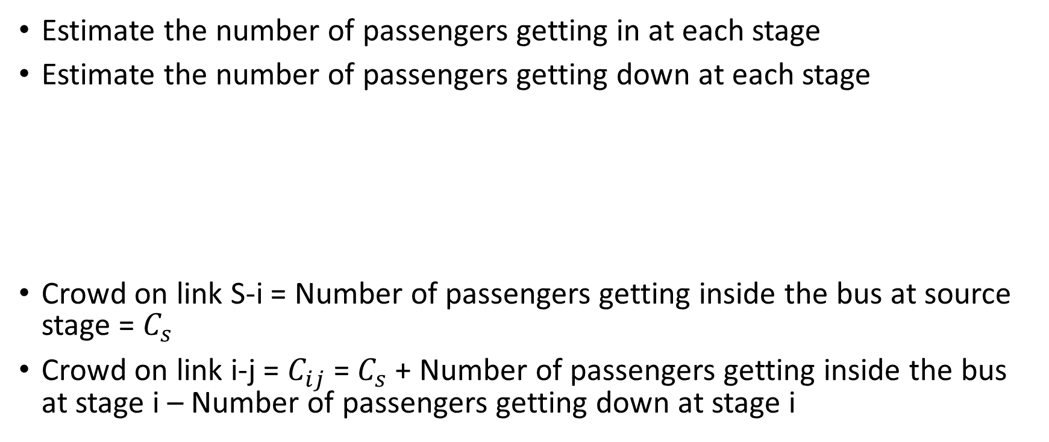
Crowding Estimation
Estimate the number of passengers getting in at each stage
Estimate the number of passengers getting down at each stage
Crowd on link S-i = Number of passengers getting inside the bus at source stage = $C_{s}$
Crowd on link i-j = $C_{ij}$ = $C_{s}$+ Number of passengers getting inside the bus at stage i – Number of passengers getting down at stage i
S
i
j

Slide 6
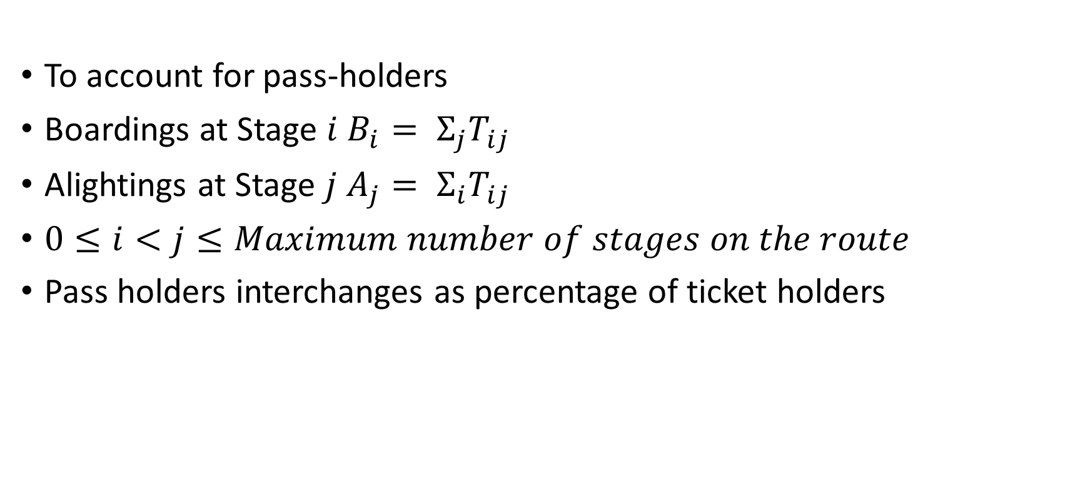
Estimating Boardings/Alightings from Interchanges
To account for pass-holders
Boardings at Stage $i$ $B_{i}= Σ_{j}T_{ij}$
Alightings at Stage $j$ $A_{j}= Σ_{i}T_{ij}$
$0≤i<j≤Maximum number of stages on the route$
Pass holders interchanges as percentage of ticket holders

Slide 7
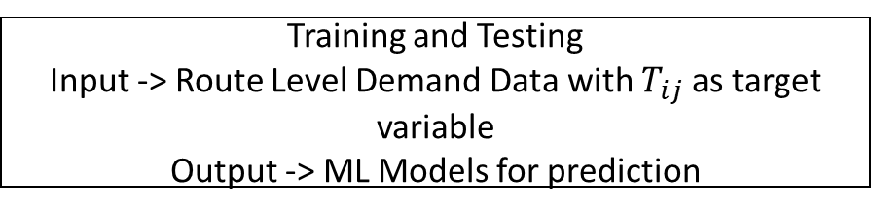
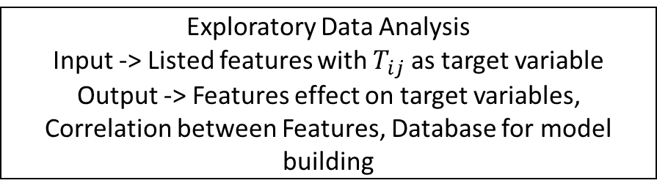
Features Extraction
Input -> Trip level demand data
Output -> Listed Features for prediction
Crowding Prediction
Exploratory Data Analysis
Input -> Listed features with $T_{ij}$ as target variable
Output -> Features effect on target variables, Correlation between Features, Database for model building
Training and Testing
Input -> Route Level Demand Data with $T_{ij}$ as target variable
Output -> ML Models for prediction
Demand Prediction
Input -> Testing data, ML Models
Output -> Real time demand data at stage

Slide 8
Factors affecting number of boarding passengers
Time of Day
Day of Week
Month of Year
Dwell time
Travel time between previous bus stop and current bus stop
Proximity to a prominent location (binary variable)
Directional changes (combined with Time of Day)

Slide 9
Factors affecting number of alighting passengers
Time of Day
Day of Week
Month of Year
Dwell time
Number of boardings at the source bus stop
Travel time between previous bus stop and current bus stop
Proximity to a prominent location (binary variable)
Directional changes (combined with Time of Day)

Slide 10
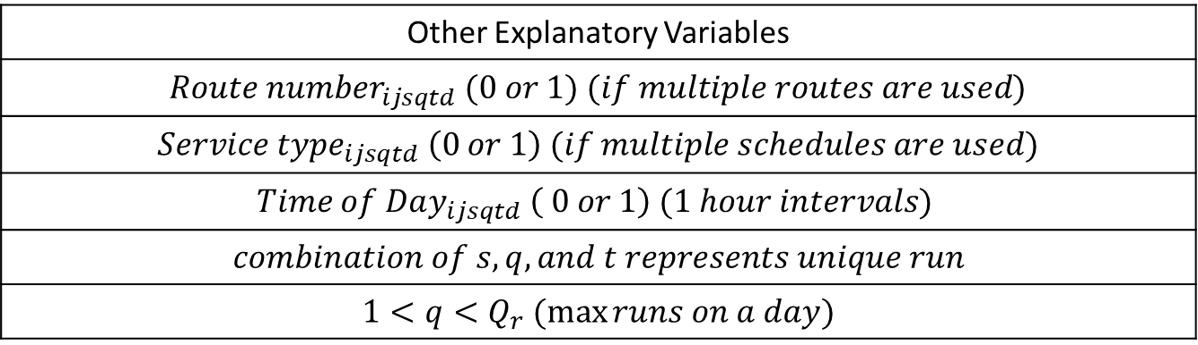
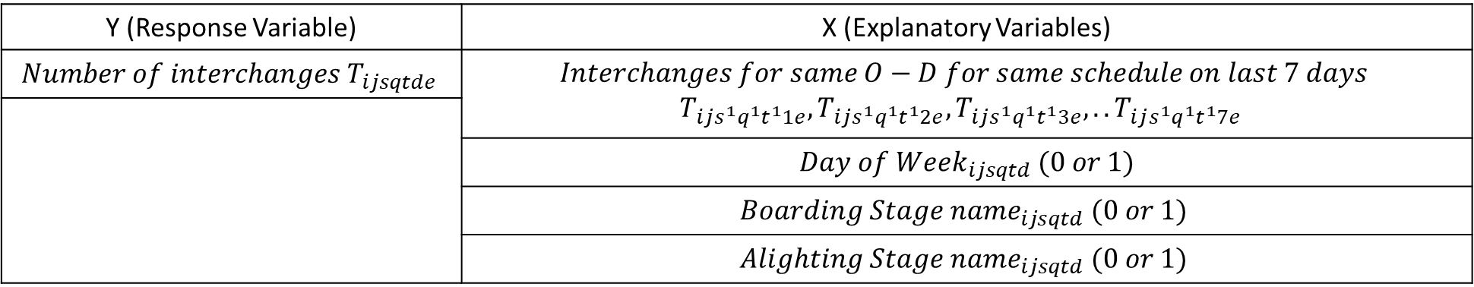
Interchanges prediction for a selected route, run and schedule on a given day. Interchanges of same run and schedule for the same route on previous days are used as explanatory variables
Y (Response Variable) | X (Explanatory Variables)
$$Number of interchanges T_{ijsqtde}$$ | $$Interchanges for same O−D for same schedule on last 7 days$$ $$T_{ijs^{1}q^{1}t^{1}1e}, T_{ijs^{1}q^{1}t^{1}2e}, T_{ijs^{1}q^{1}t^{1}3e},..T_{ijs^{1}q^{1}t^{1}7e}$$
 | $$Day of Week_{ijsqtd} (0 or 1)$$
 | $$Boarding Stage name_{ijsqtd} (0 or 1)$$
 | $$Alighting Stage name_{ijsqtd} (0 or 1)$$
Other Explanatory Variables
$Route number_{ijsqtd} (0 or 1)$ $(if multiple routes are used)$
$Service type_{ijsqtd} \left(0 or 1\right)$ $(if multiple schedules are used)$
$$Time of Day_{ijsqtd} \left( 0 or 1\right) (1 hour intervals)$$
$$combination of s,q, and t represents unique run$$
$$1<q<Q_{r} (\max{runs on a day)}$$
Both linear (Linear Regression) and non-linear (ANN’s) models can be developed which gives us the functional relationship between the Feature Vector and the Response Variables.

Slide 11
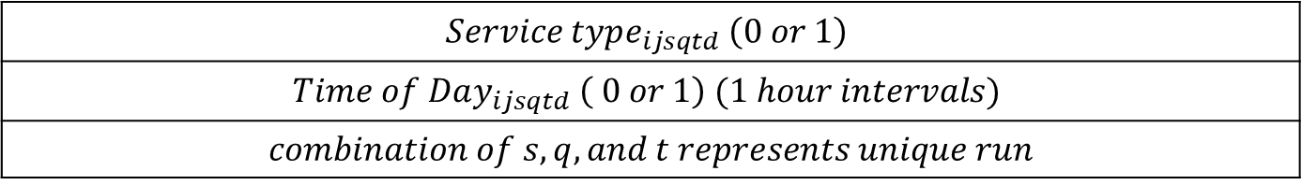
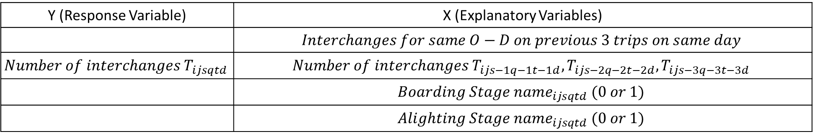
Interchanges prediction for a selected route, run and schedule on a given day. Interchanges of previous runs of the same route on the same day are used as explanatory variables
Y (Response Variable) | X (Explanatory Variables)
 | $$Interchanges for same O−D on previous 3 trips on same day$$
$$Number of interchanges T_{ijsqtd}$$ | $$Number of interchanges T_{ijs−1q−1t−1d}, T_{ijs−2q−2t−2d}, T_{ijs−3q−3t−3d}$$
 | $$Boarding Stage name_{ijsqtd} (0 or 1)$$
 | $$Alighting Stage name_{ijsqtd} (0 or 1)$$
$$Service type_{ijsqtd} \left(0 or 1\right)$$
$$Time of Day_{ijsqtd} \left( 0 or 1\right) (1 hour intervals)$$
$$combination of s,q, and t represents unique run$$
Both linear (Linear Regression) and non-linear (ANN’s) models can be developed which gives us the functional relationship between the Feature Vector and the Response Variables.

Slide 12
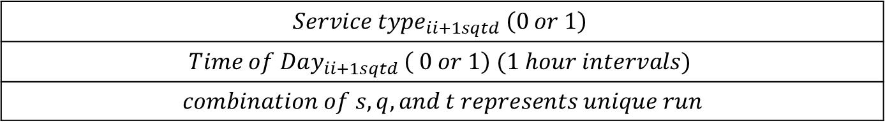
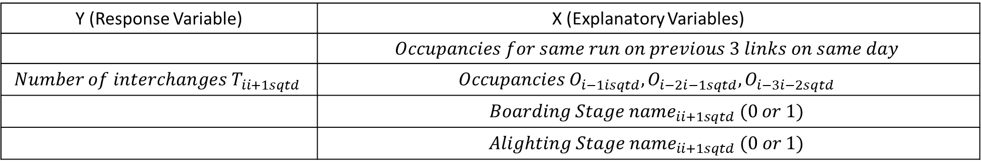
Interchanges prediction for a selected route, run and schedule on a given day. Occupancy of the last three links of the same run are used as explanatory variables
Y (Response Variable) | X (Explanatory Variables)
 | $$Occupancies for same run on previous 3 links on same day$$
$$Number of interchanges T_{ii+1sqtd}$$ | $$Occupancies O_{i−1isqtd}, O_{i−2i−1sqtd}, O_{i−3i−2sqtd}$$
 | $$Boarding Stage name_{ii+1sqtd} (0 or 1)$$
 | $$Alighting Stage name_{ii+1sqtd} (0 or 1)$$
$$Service type_{ii+1sqtd} \left(0 or 1\right)$$
$$Time of Day_{ii+1sqtd} \left( 0 or 1\right) (1 hour intervals)$$
$$combination of s,q, and t represents unique run$$
Both linear (Linear Regression) and non-linear (ANN’s) models can be developed which gives us the functional relationship between the Feature Vector and the Response Variables.

